Slide 1
Disney+HotStar Data Analysis
Shreyas Reddy Kanthareddy

Slide 2
Problem Statement:
Provide an in-depth analysis and visualization of a movie dataset to uncover insights and trends. This includes understanding the distribution of movies by genre, running times, release years, age ratings, and other attributes.
Approach:
1. Data Loading: Load the provided dataset into Tableau/Power BI.
2. Data Cleaning: Inspect the data for any missing or inconsistent values and clean it as necessary.
3. Data Visualization: Create various visualizations to analyze and interpret the data.
4. Exploratory Analysis: Perform EDA to uncover patterns, trends, and insights.
5. Documentation: Document the findings and visualizations in a report or presentation format.

Slide 3
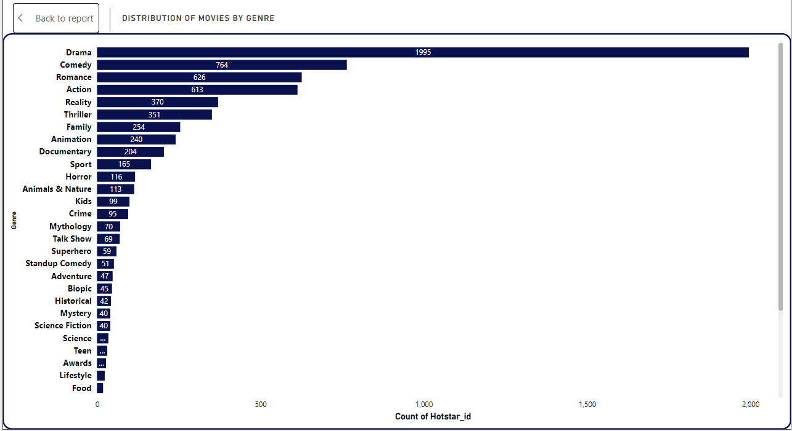
1. Distribution of Movies by Genre: Create a bar chart to show the count of movies for each genre.
Bar chart is used for the above task to show the count of the movies according to the genre.
The genre ‘Drama’ has the most number of movies with 1995 in number followed by comedy with 764.
The genre ‘Football’, ‘Formula E’, and ‘Kabbadi’ has 1 movie each.

Slide 4
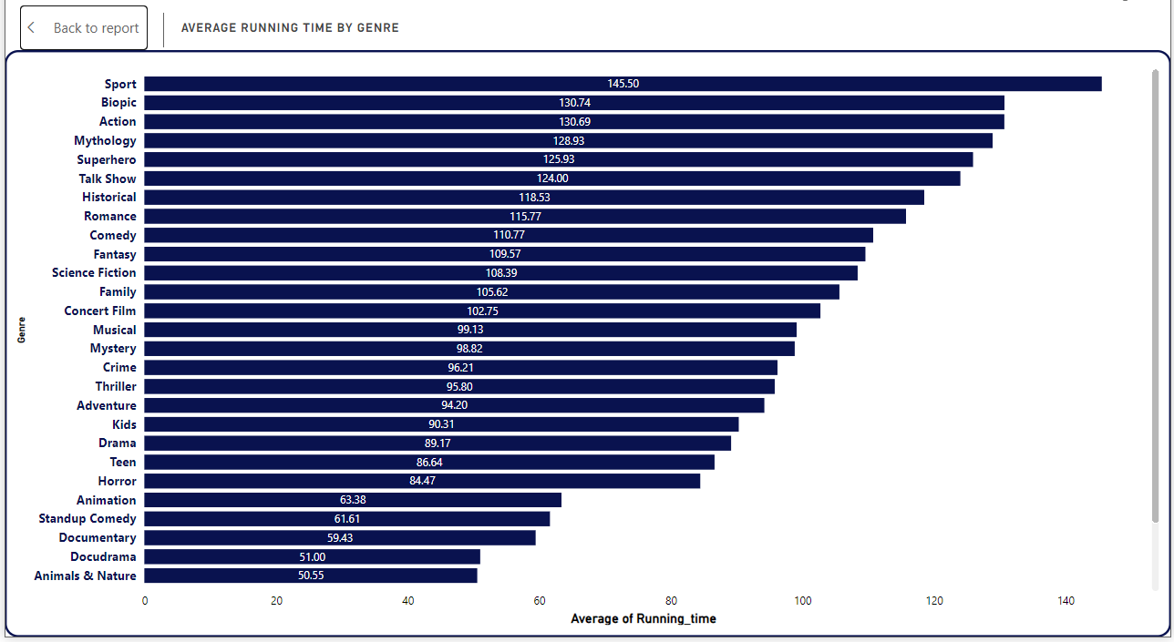
2. Average Running Time by Genre: Calculate the average running time for movies in each genre and visualize this using a bar chart.
For this task bar chart has been used to calculate the average running time for movies for each genre.
The genre ‘Sport’ has the average time of 145.50 mins followed by ‘Biopic’ with 130.74 mins.
‘Travel’ and ‘Shorts’ has the average time of 18 and 6.75 mins, respectively.

Slide 5
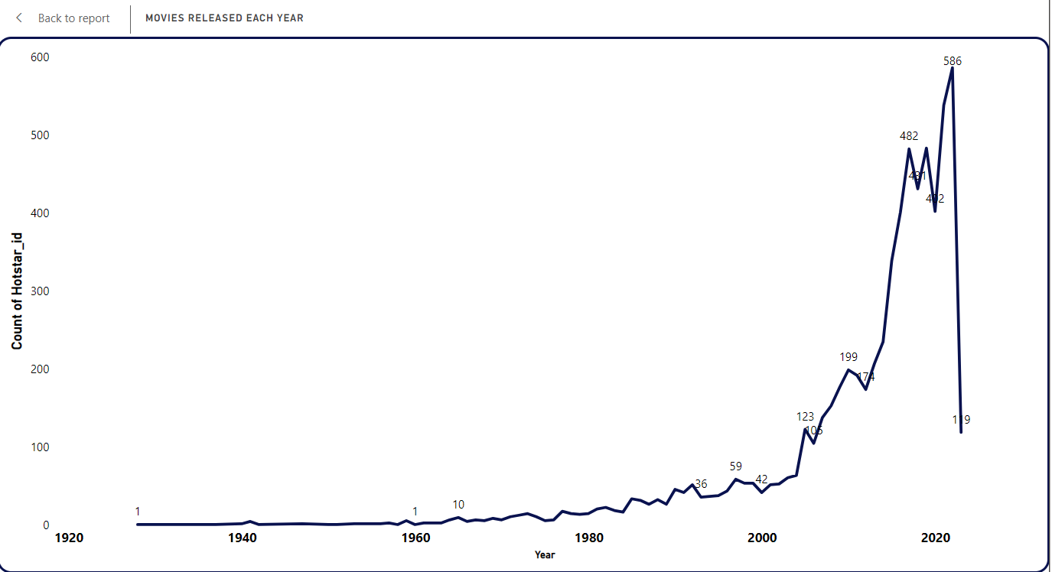
3. Movies Released Each Year: Create a line chart to show the number of movies released each year.
Line chart is used to analyze the number of movies released each year.
Up till 1965 not more than 5 movies used to get released each year. In 1965, 10 movies released. After that the number increased.
In 2022, 586 movies released which is the highest but in 2023, the number decreased to 119 which is just 20% of the previous year.

Slide 6
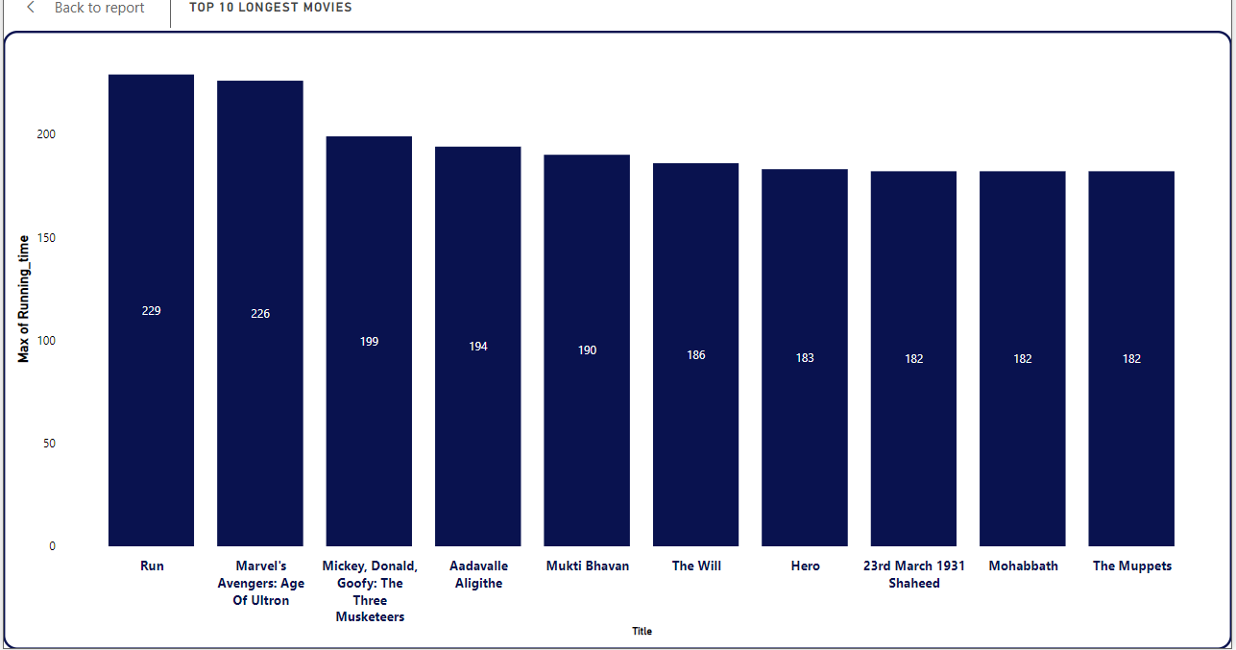
4. Top 10 Longest Movies: Identify and visualize the top 10 longest movies based on running time.
A column chart is used to identify and analyze the top 10 longest movies based on the movie’s running time.
The movie ‘Run’ has the highest running time of 229 mins, followed by ‘Marvel’s Avengers: Age of Ultron’ with 226 mins.

Slide 7
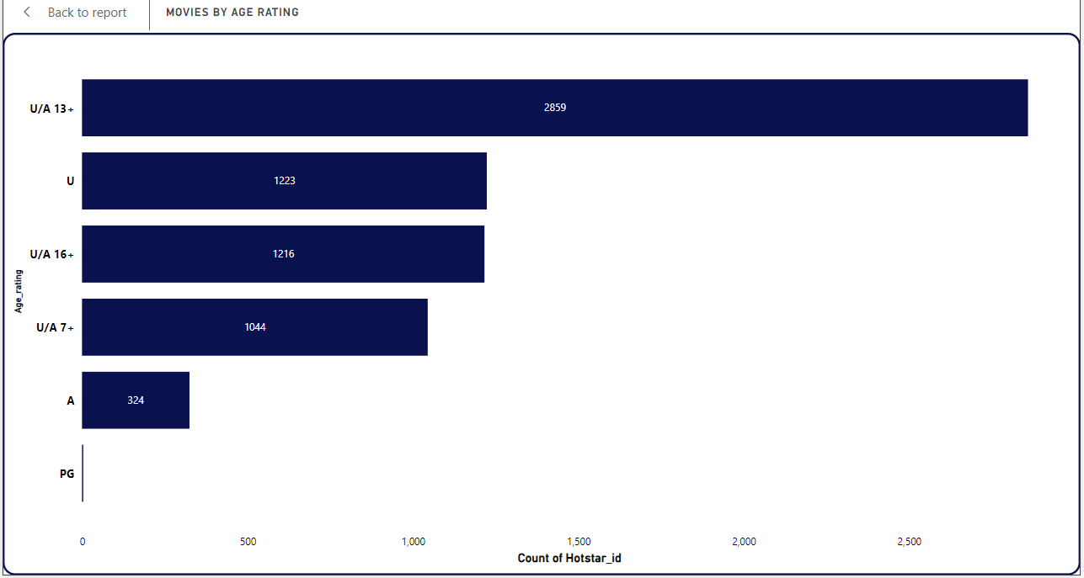
5. Movies by Age Rating: Show the distribution of movies by age rating.
A bar graph is used to analyze this task.
Most of the movies lies under the rating ‘U/A 13+’ with 2859 in number followed by ‘U’ and ‘U/A 16+’ with 1223 and 1216, respectively.
Under parental guidance ‘PG’ there is only 1 movie.

Slide 8
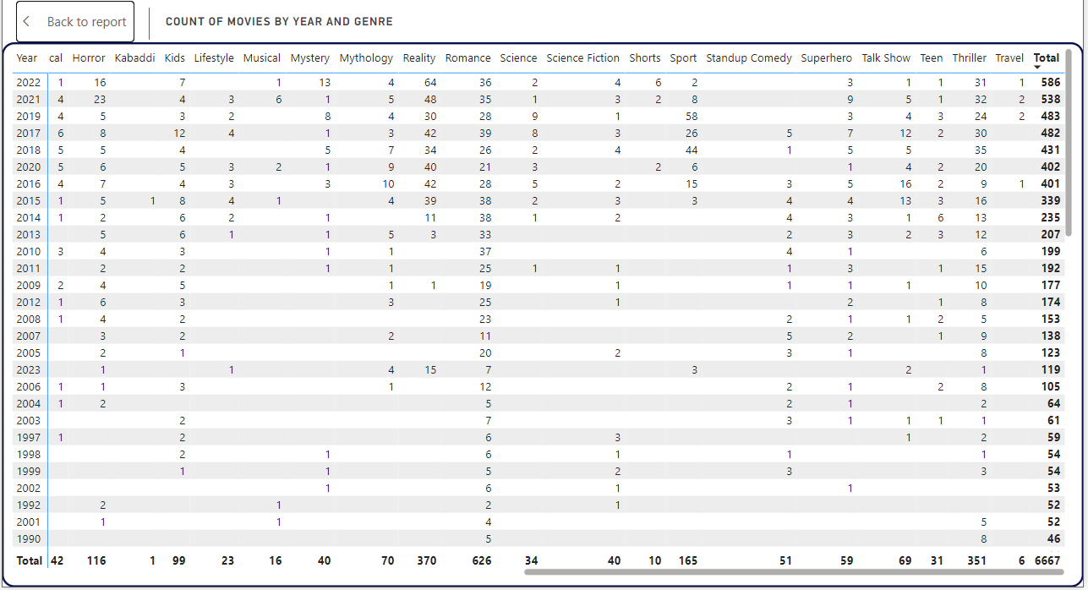
6. Count of Movies by Year and Genre: Show the count of movies for each genre over the years.
Matrix chart is used calculate the count of movies for each genre over the years.
It has been observed that the number of films being released has increased over time.
Genres such as ‘Drama’, ‘Comedy’, and ‘Action’ has the highest number of releases in each year.

Slide 9
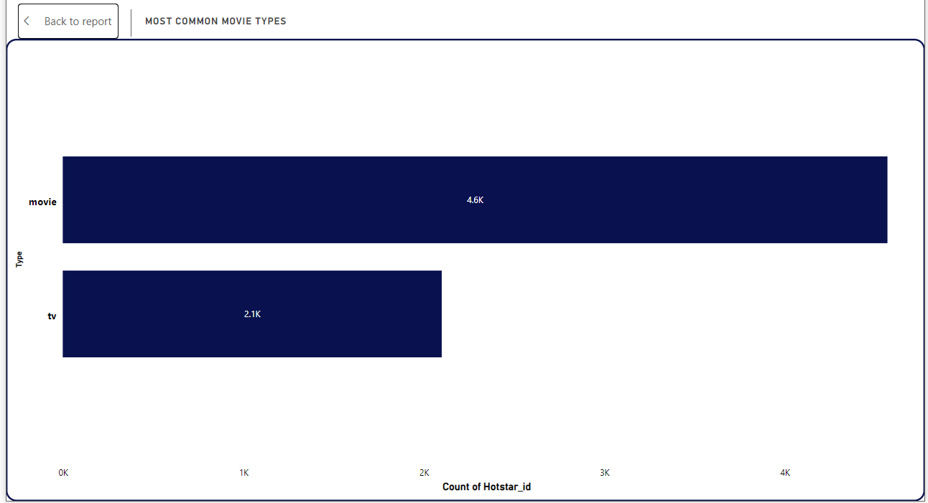
7. Most Common Movie Types: Create a bar chart showing the number of movies for each type (movie, documentary, etc.).
A bar chart has been used identify the different types of audiovisual content.
Movies are the most common type with 4568 in number, followed by TV series with 2099 in number.

Slide 10
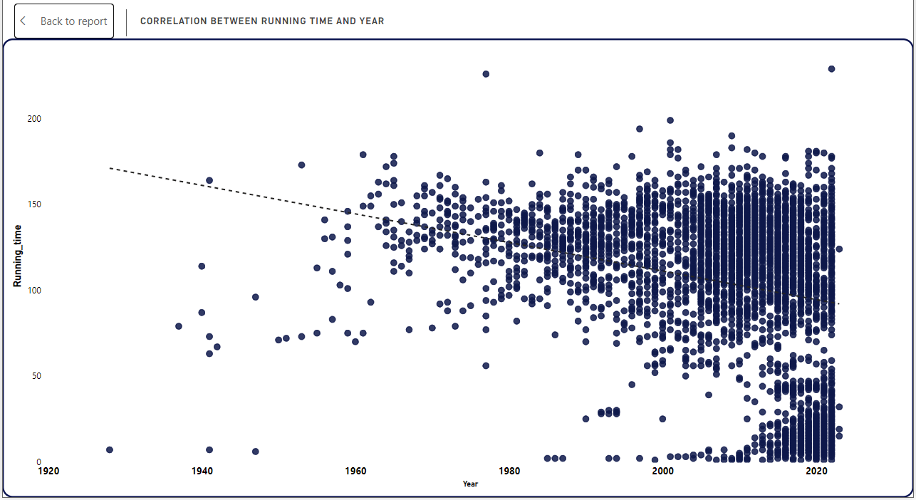
8. Correlation Between Running Time and Year: Create a scatter plot to explore the relationship between the running time of movies and their release year.
A scatter plot is used to analyze the correlation between running time and released year.
From the 1960s onwards, there is an increase in the density of data points, indicating more movies or samples being recorded over time.
Couple of movies have exceptionally long running times, exceeding 200 minutes.
There is no strong linear correlation between year and running time. While variability decreases over time, running time does not significantly increase or decrease with year.

Slide 11
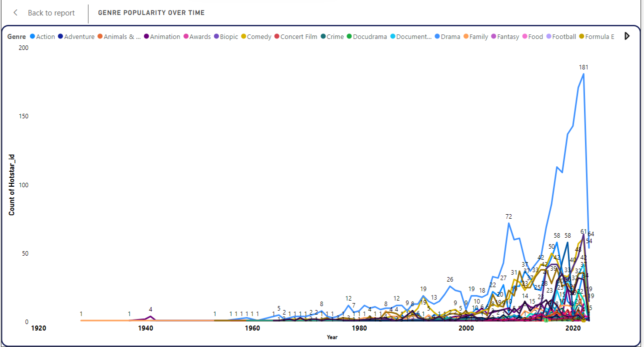
9. Genre Popularity Over Time: Create a line chart to show how the popularity of different genres has changed over time.
A line chat is used to understand the genre popularity and growth over the years.
Up till 1955 there were only two genres (animation and family) in the movie industry. From 1955, movies with drama genre started. It peaked in the year 2022 with 181 movies.
Along with drama, both action and comedy genres have increased in numbers.

Slide 12
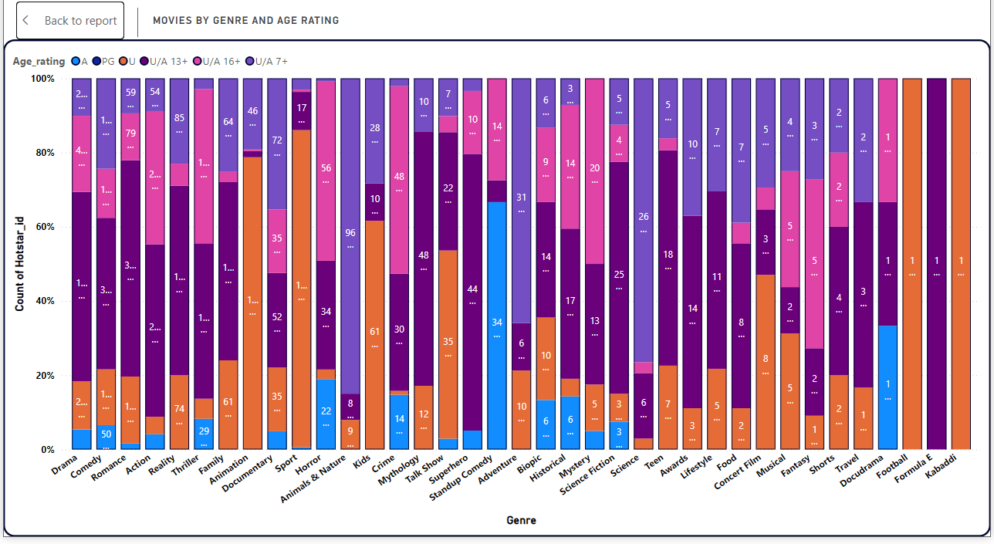
10. Movies by Genre and Age Rating: Show the count of movies for each combination of genre and age rating.
For this task, 100% stacked column chart has been utilized to know the genres are predominantly aimed at specific audiences.
Most of the genre lies under U/A 13+ and U/A 16+.

Slide 13
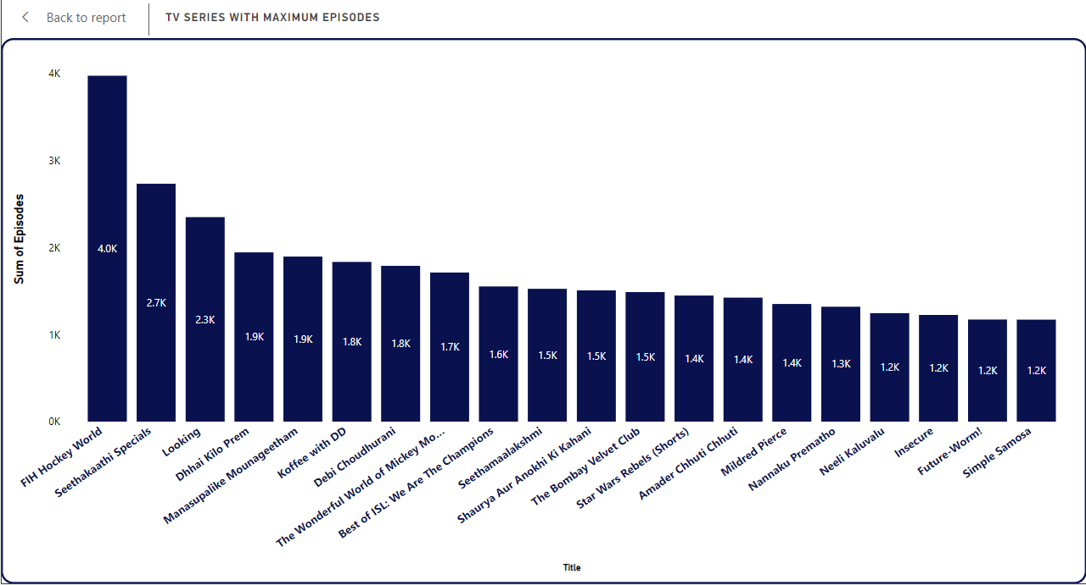
11. TV series with Maximum Episodes: Identify the TV series with the maximum number of episodes and visualize them.
Column chart is used to understand the TV series with the maximum number of episodes.
Identified top 20 with maximum episodes in the TV series.
With 3973 episodes, FIH Hockey World is ranked the longest TV series with 67 seasons. Followed by Seethakaathi Specials with 2732 episodes.

Slide 14
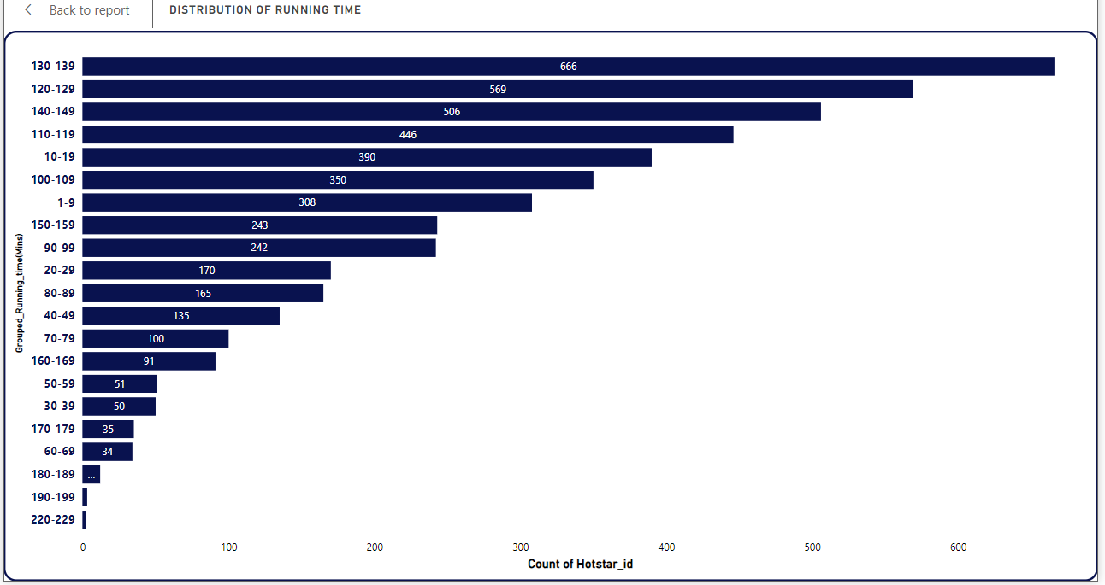
12. Distribution of Running Time: Show the distribution of running times for all movies.
Running time is segregated into different sections to know the running times.
Majority (666) of movie’s running time lies between 130-139 mins. Followed by 120-129 mins with 569 movies.
There are only 5 movies beyond 190 mins.

Slide 15
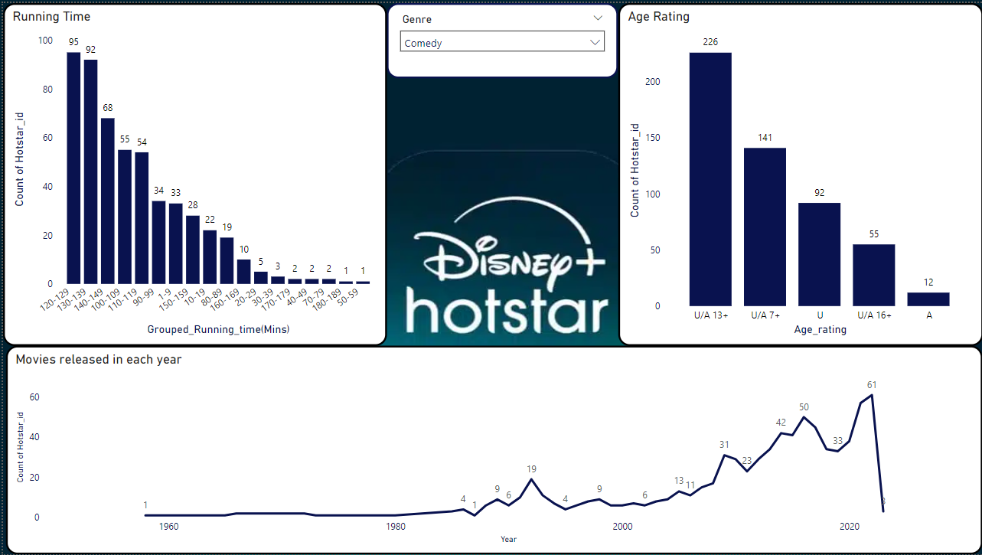
13. Analysis of Specific Genres: Choose a specific genre (e.g., Action, Drama) and analyze various attributes like running time, year of release, age rating, etc.
For this task I have created 3 visual charts with ‘Comedy’ as the Genre.
Most of the comedy movies have the running time between 120-140 mins.
Bar graph is used to identify where most of the comedy movies are distributed according to age rating. U/A 13+ has 226 movies.
Comedy movies gradually increased from year 1995.

Slide 16
Drama is super popular. Creating even better dramas and trying out new types within the genre could make Hotstar even stronger.
RECOMMENDATIONS
Disney+Hotstar must increase the movies in different genre such as horror, animation, superhero, science fiction, and historical to attract more viewers.
A lot of content currently falls under the U/A rating, which is great for mixed audiences. But there’s an opportunity to offer specifically to families with more kid-friendly content.
Create more content in the 120–139 mins range since it's the most popular. Include shorter content (under 90 minutes) and longer content (over 150 minutes) to attract different types of viewers.
Drama and action are popular genre in Disney+Hoststar. Trying out new types within these genre could make Hotstar even stronger.

Slide 17
THANK YOU

